Slide 1
高等机器学习
Advanced Machine Learning
§2 神经网络表示2
Representation for neural networks
滕佳烨
上海财经大学
www.tengjiaye.com
高等机器学习 Advanced Machine Learning
机器学习 Machine Learning
滕佳烨 Jiaye Teng, 上海财经大学 SUFE

Slide 2
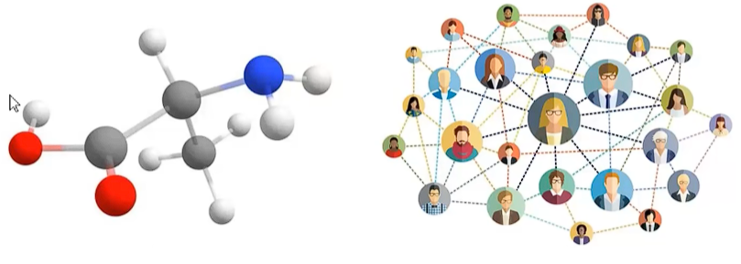
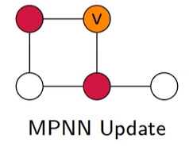
Graph Neural Network(GNN)
Graph Neural Network is one kind of neural net work that takes graphs as inputs:
One significant GNN among those is Message Passing Neural Network(MPNN):
高等机器学习 Advanced Machine Learning
机器学习 Machine Learning
滕佳烨 Jiaye Teng, 上海财经大学 SUFE

Slide 3
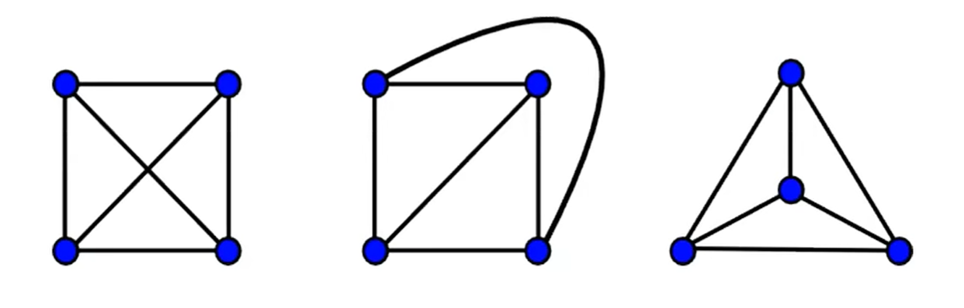
Expressive Power of GNNs
We wish to use GNN to study the property of certain graph by studying the structure of different graphs.
By “different structures”, basically it means we wish GNN are able to tell graphs that are topologically different from others.
Following are graphs that looks different but de facto topologically the same.
高等机器学习 Advanced Machine Learning
机器学习 Machine Learning
滕佳烨 Jiaye Teng, 上海财经大学 SUFE

Slide 4
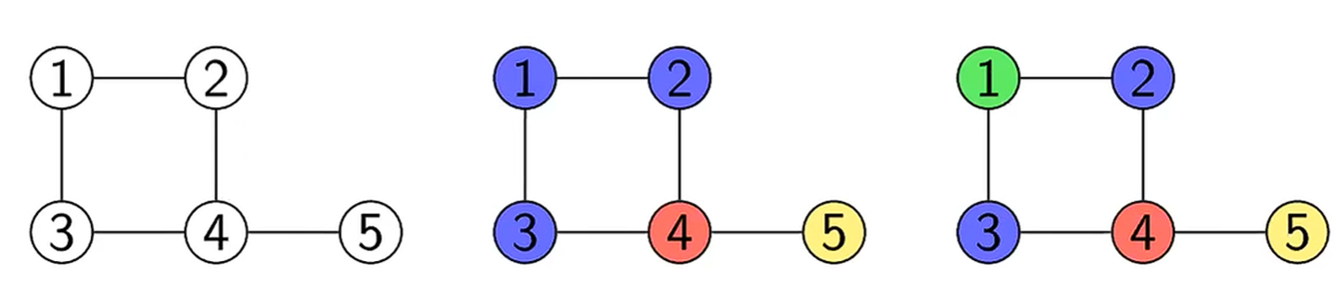
Expressive Power of GNNs
The reality is, however, there is no polynomial approach to distinguish the topological structure of two graphs.
In this paper, the core idea of “expressive power” would be if the GNN are able to distinguish graphs that are topologically different.
Such problem can be related by a classic algorithm called Weisfeiler-Lehman Test(WL-test):
高等机器学习 Advanced Machine Learning
机器学习 Machine Learning
滕佳烨 Jiaye Teng, 上海财经大学 SUFE

Slide 5
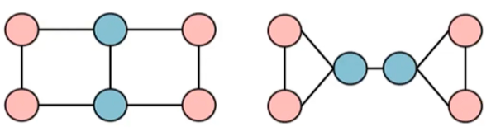
1-WL test
The 1-WL test differs graphs by appointing each vertices a “color”(by hash function) If the color for each nodes are identical to its corresponding counterpart, then the pair of graphs are the same.
1-WL may fail, even on some of the simplest cases:
One may wonder: is there a way to go beyond this 1-WL test?
高等机器学习 Advanced Machine Learning
机器学习 Machine Learning
滕佳烨 Jiaye Teng, 上海财经大学 SUFE

Slide 6
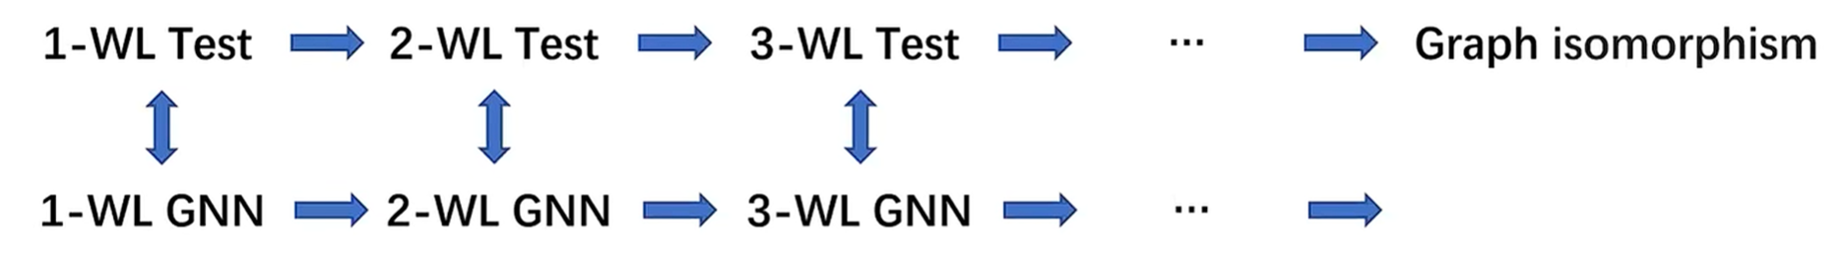
Higher order WL test
By applying higher order of WL test, one may able to obtain GNN with better performance…but at what cost?
1.Computationally expensive
2.Coarse bound between 1- and 3-WL test
3.Unclear about the necessity for real world task
We wish to design one kind of method that transcend WL test and presents provably better GNN structures
高等机器学习 Advanced Machine Learning
机器学习 Machine Learning
滕佳烨 Jiaye Teng, 上海财经大学 SUFE

Slide 7
Biconnectivity
Connectivity: A graph is connected if for any two nodes{u,v}, there is a path goes from u to v.
Cut Vertex(Edge): A node is called a cut vertex(edge) of graph G if by removing this vertex(edge) increases the number of connected components.
A graph is Biconnected if it has no cut edge or vertex.
高等机器学习 Advanced Machine Learning
机器学习 Machine Learning
滕佳烨 Jiaye Teng, 上海财经大学 SUFE

Slide 8
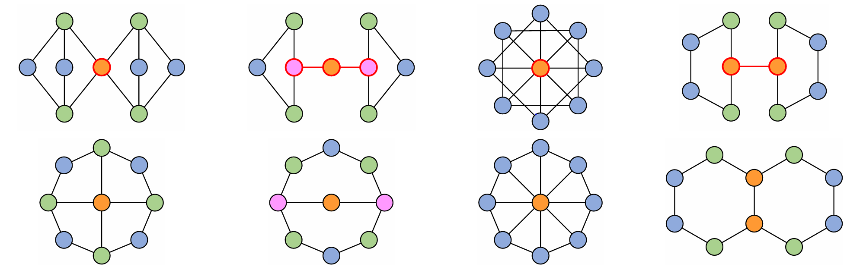
Biconnectivity
We loose the condition for expressiveness from telling whether two graphs are topologically the same(isomorphism) to telling whether two graphs are simultaneously biconnected or non-biconnected
Following are four pairs of graphs that components in the first row are non-biconnected and the second row is biconnected. While the classic 1-WL test can’t tell the difference:
高等机器学习 Advanced Machine Learning
机器学习 Machine Learning
滕佳烨 Jiaye Teng, 上海财经大学 SUFE

Slide 9
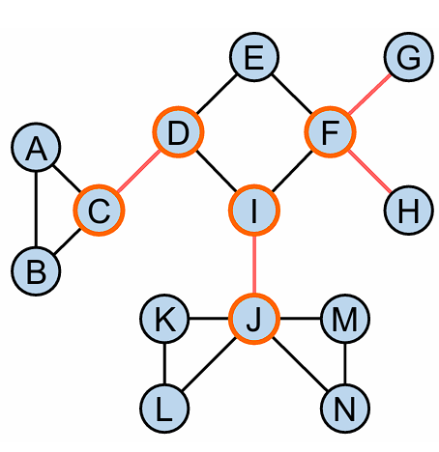
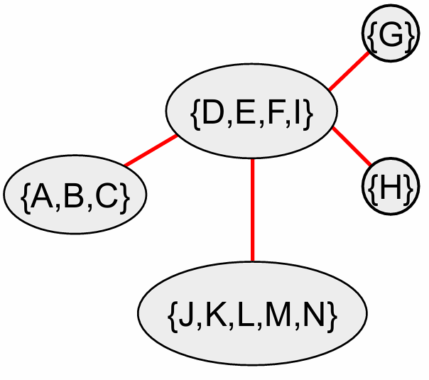
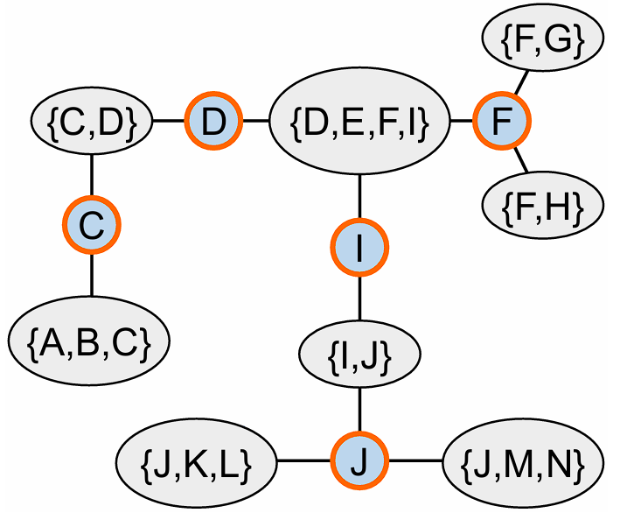
Biconnectivity
For one graph:
we can also define the block cut-edge tree and block cut-vertex tree by denoting the cut-edge and cut-vertex:
高等机器学习 Advanced Machine Learning
机器学习 Machine Learning
滕佳烨 Jiaye Teng, 上海财经大学 SUFE

Slide 10
Biconnectivity
Several problems related to biconnectivity:
Distinguish whether a graph is vertex/edge-biconnected
Identifying a cut-vertex
Identifying a cut-edge
Distinguish block cut-edge/vertex trees of certain graph.
It is provable that the difficulty goes up from 1to4 and by solving the hardest one(4) we can solve all of the other 3 problems
高等机器学习 Advanced Machine Learning
机器学习 Machine Learning
滕佳烨 Jiaye Teng, 上海财经大学 SUFE

Slide 11
Motivation
Can we propose a principled and efficient GNN that framework with provable expressiveness for biconnectivity
One may start with Color-Refinement algorithm that the classic 1-WL test applies:
We argue that one reason why CR algorithm fails is that it takes only the neighbor of each nodes without looking ahead of them.
By taking the “distance” into the aggregation procedure.
One might be able to solve this.
高等机器学习 Advanced Machine Learning
机器学习 Machine Learning
滕佳烨 Jiaye Teng, 上海财经大学 SUFE

Slide 12
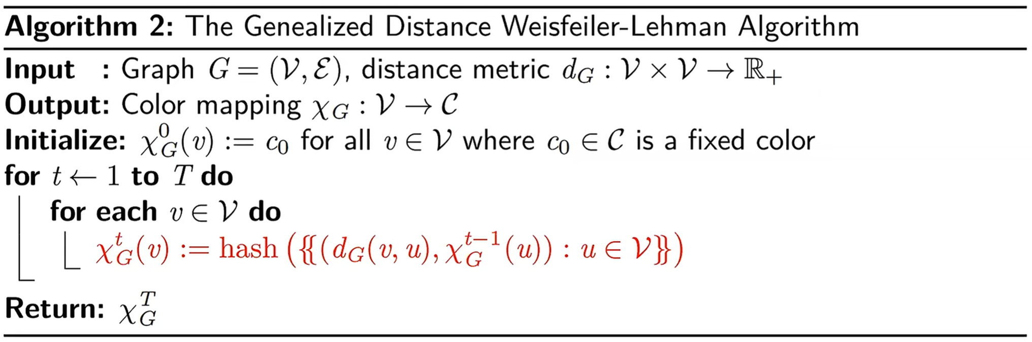
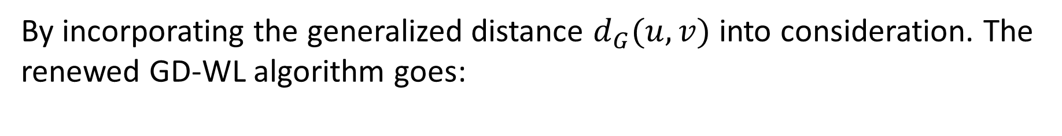
Generalized-Distance WL
By incorporating the generalized distance $d_{G}(u,v)$ into consideration. The renewed GD-WL algorithm goes:
高等机器学习 Advanced Machine Learning
机器学习 Machine Learning
滕佳烨 Jiaye Teng, 上海财经大学 SUFE

Slide 13
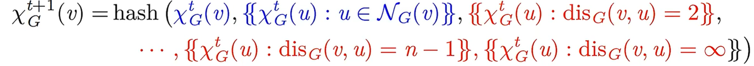
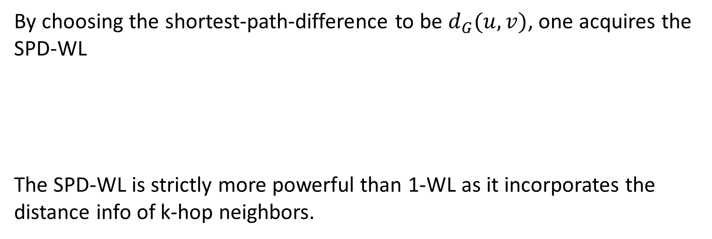
Shortest-Path-Distance WL
By choosing the shortest-path-difference to be $d_{G}(u,v)$, one acquires the SPD-WL
The SPD-WL is strictly more powerful than 1-WL as it incorporates the distance info of k-hop neighbors.
高等机器学习 Advanced Machine Learning
机器学习 Machine Learning
滕佳烨 Jiaye Teng, 上海财经大学 SUFE

Slide 14
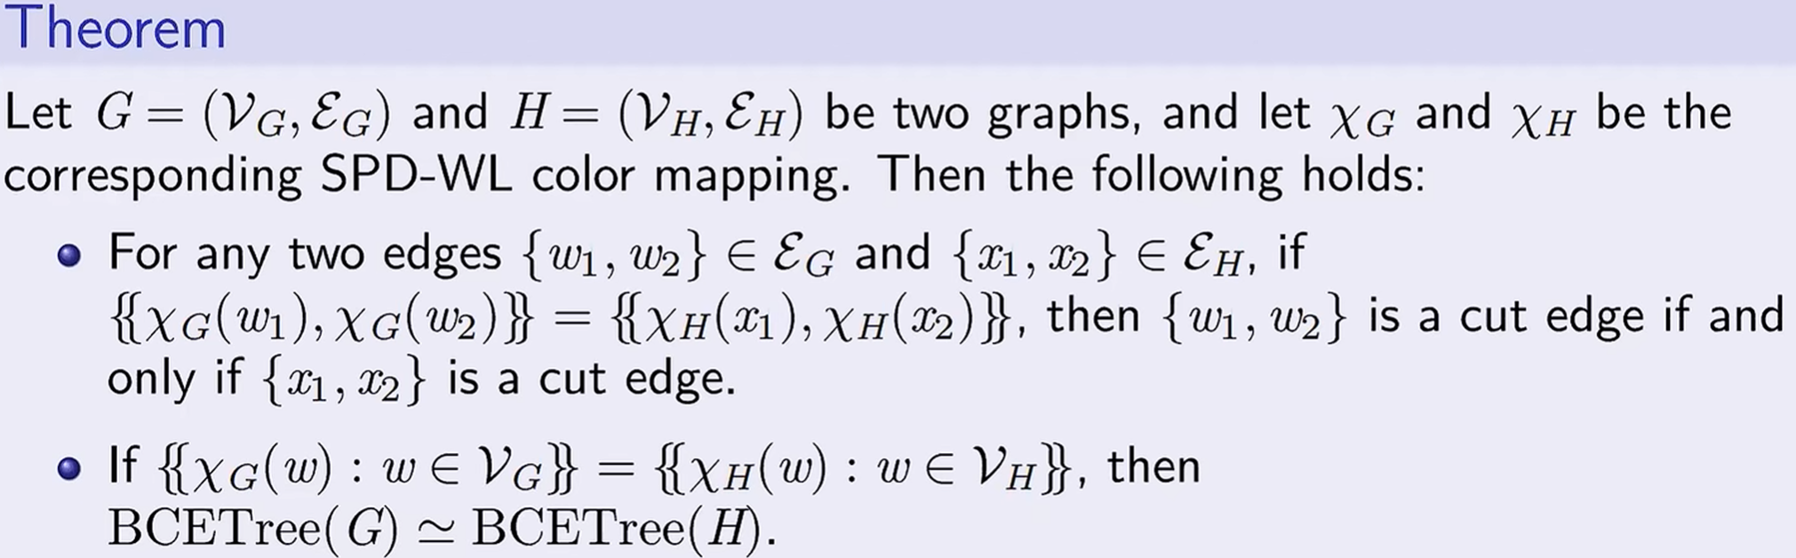
Shortest-Path-Distance WL
We would say that the SPD-WL is provably expressive for cut-edge trees and thus edge-biconnectivity issue:
This outcome is highly non-trivial as it combines SPD, WL-test and biconnectity, yet it still can’t deal with vertex-biconnectivity.
高等机器学习 Advanced Machine Learning
机器学习 Machine Learning
滕佳烨 Jiaye Teng, 上海财经大学 SUFE

Slide 15
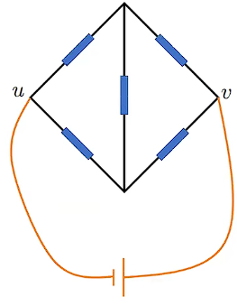
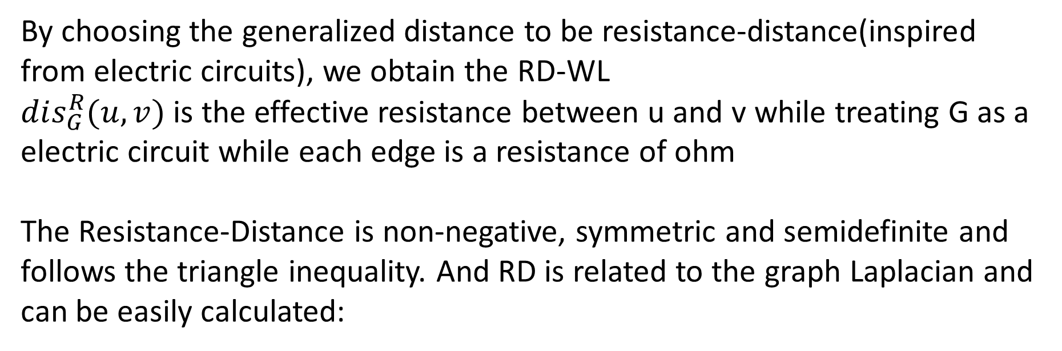
Resistance-Distance WL
By choosing the generalized distance to be resistance-distance(inspired from electric circuits), we obtain the RD-WL
$dis_{G}^{R}(u,v)$ is the effective resistance between u and v while treating G as a electric circuit while each edge is a resistance of ohm
The Resistance-Distance is non-negative, symmetric and semidefinite and follows the triangle inequality. And RD is related to the graph Laplacian and can be easily calculated:
高等机器学习 Advanced Machine Learning
机器学习 Machine Learning
滕佳烨 Jiaye Teng, 上海财经大学 SUFE

Slide 16
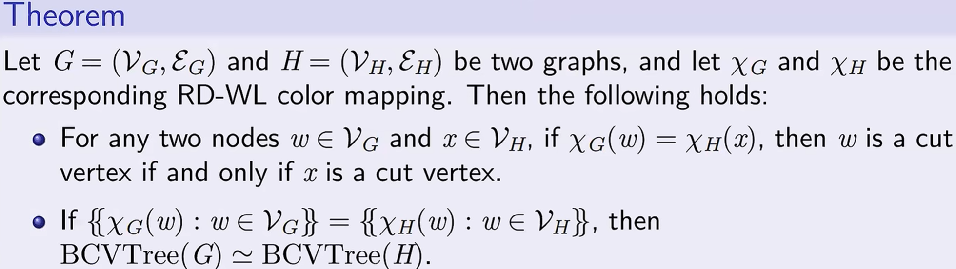
Resistance-Distance WL
Similarly, by applying RD-WL
RD-WL is fully expressive for vertex-biconnectivity problem.
Thus by applying both RD and SPD WL, one can obtain a GD-WL that works for both vertex and edge biconnectivity problem.
高等机器学习 Advanced Machine Learning
机器学习 Machine Learning
滕佳烨 Jiaye Teng, 上海财经大学 SUFE

Slide 17
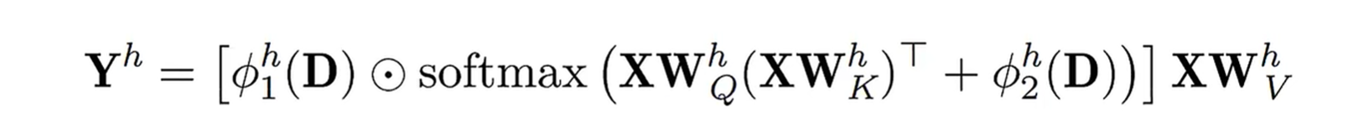
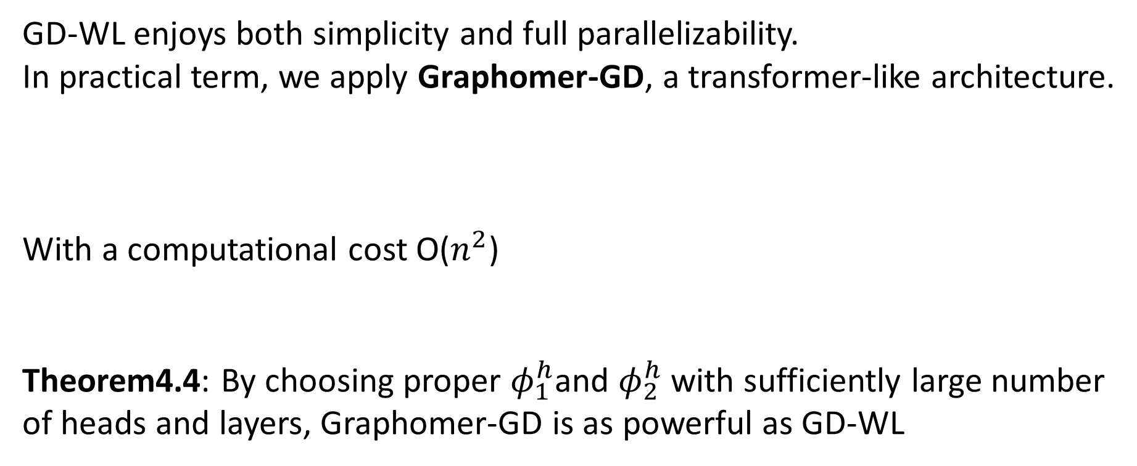
Practical Implementation
GD-WL enjoys both simplicity and full parallelizability.
In practical term, we apply Graphomer-GD, a transformer-like architecture.
With a computational cost O($n^{2}$)
Theorem4.4: By choosing proper $φ_{1}^{h}$and $φ_{2}^{h}$ with sufficiently large number of heads and layers, Graphomer-GD is as powerful as GD-WL
高等机器学习 Advanced Machine Learning
机器学习 Machine Learning
滕佳烨 Jiaye Teng, 上海财经大学 SUFE

Slide 18
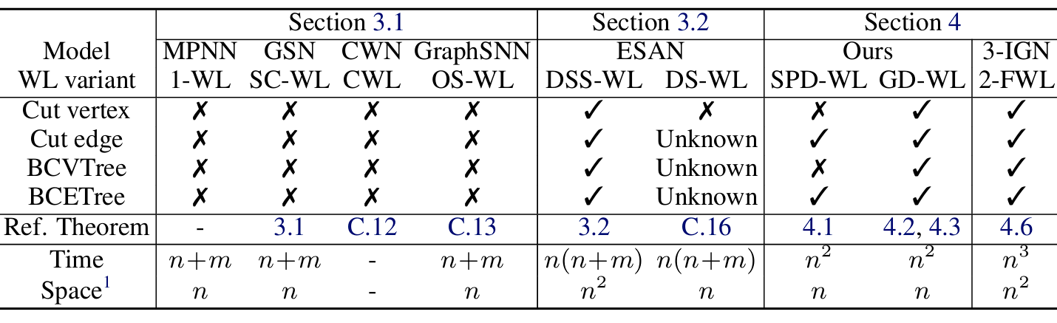
Upper bound of GD-WL
Theorem4.5: The 2-FWL(3-WL) is more powerful than both SPD-WL and RD-WL.
Corollary4.6: The 2-FWL is also fully expressive for both vertex-biconnecticity and edge-biconnectivity
We can see that GD-WL is a cheaper alternative of higher-order WL
高等机器学习 Advanced Machine Learning
机器学习 Machine Learning
滕佳烨 Jiaye Teng, 上海财经大学 SUFE

Slide 19
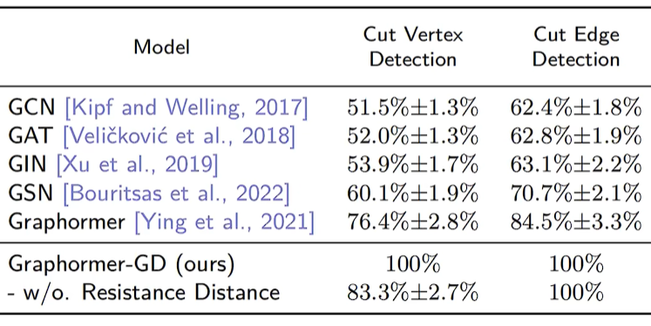
Experimental Outcome: Detecting Cut-Vertex/Edge
Accuracy of different model versus Graphomer-GD:
We can see that our Graphomer-GD outperform all other model by achieving a 100% accuracy, which aligns with our theory.
高等机器学习 Advanced Machine Learning
机器学习 Machine Learning
滕佳烨 Jiaye Teng, 上海财经大学 SUFE

Slide 20
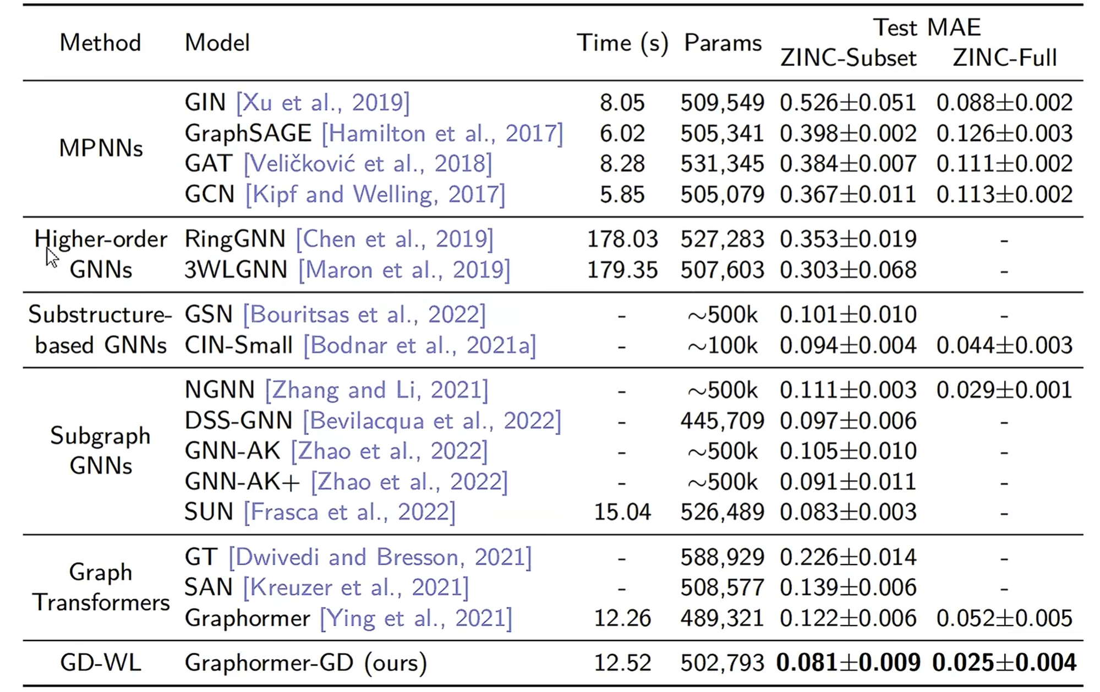
Experimental Outcome: ZINC dataset
高等机器学习 Advanced Machine Learning
机器学习 Machine Learning
滕佳烨 Jiaye Teng, 上海财经大学 SUFE

Slide 21
Open Directions
Is there any other structure that can outperform GD-WL?
A deeper understanding of how GD-WL achieves its ability.
Any more powerful distance metric other than SPD and RD?
Is there a way of other presentation for expressiveness other than biconnectivity?
高等机器学习 Advanced Machine Learning
机器学习 Machine Learning
滕佳烨 Jiaye Teng, 上海财经大学 SUFE

